Slide 1
What’s ur ulam, Pare?
By:
Fernandez, Evan Lorenz David
Fundales, Julianne Suarez
Geronimo, Michael Robert Garcia

Slide 2
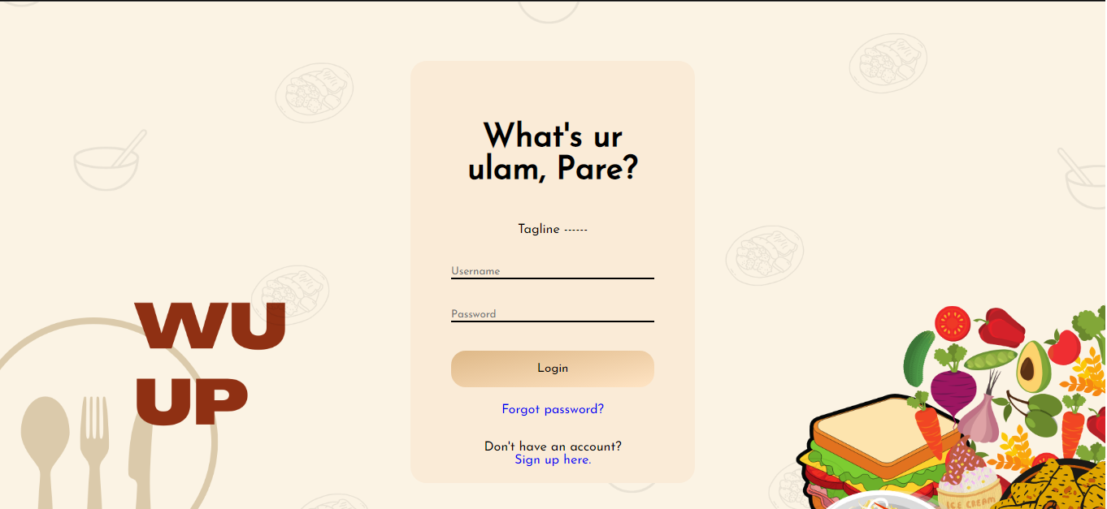
Features
Login/Logout

Slide 3
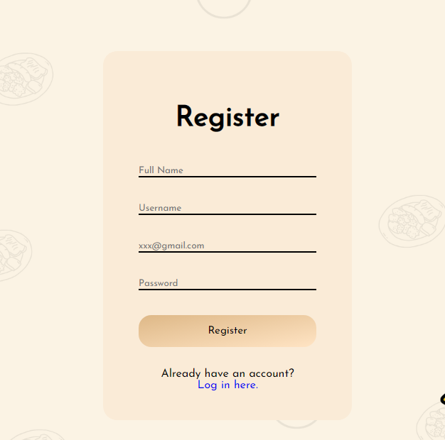
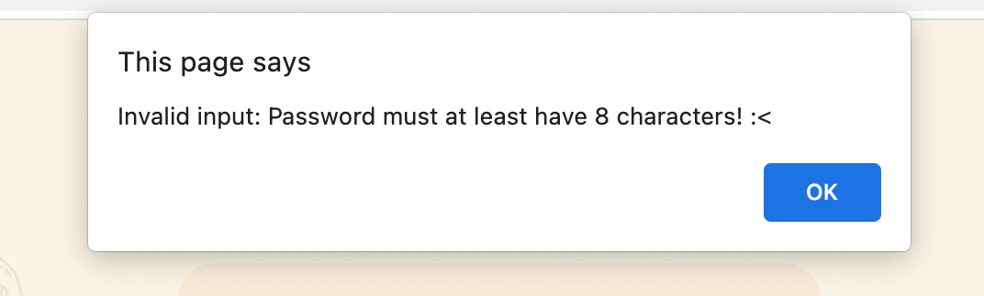
Register

Slide 4
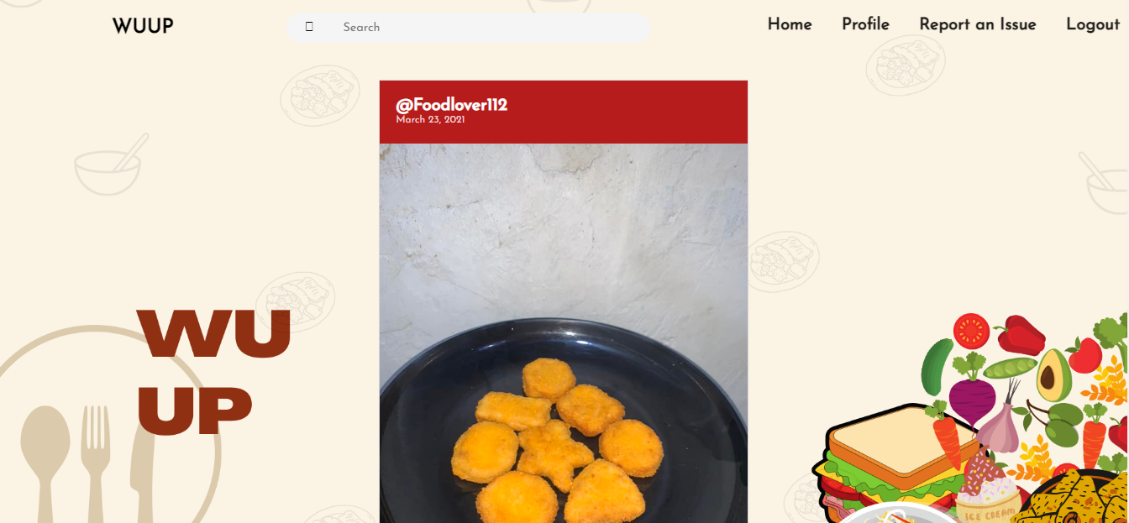
Homepage

Slide 5


Create Post

Slide 6
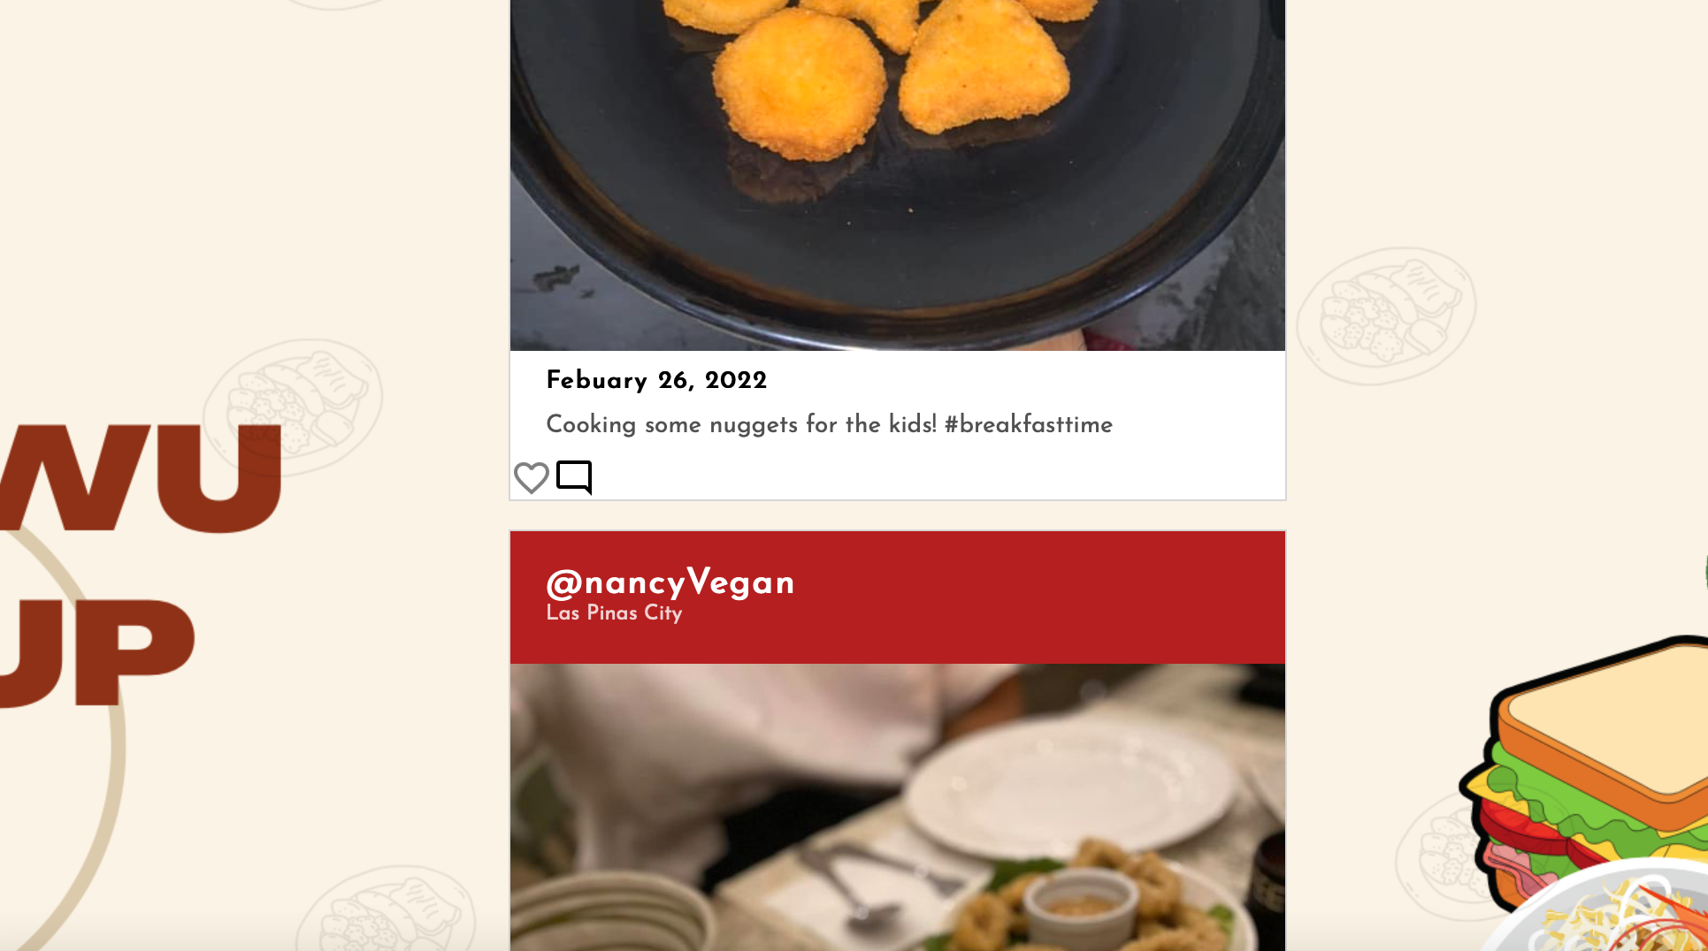
Like

Slide 7
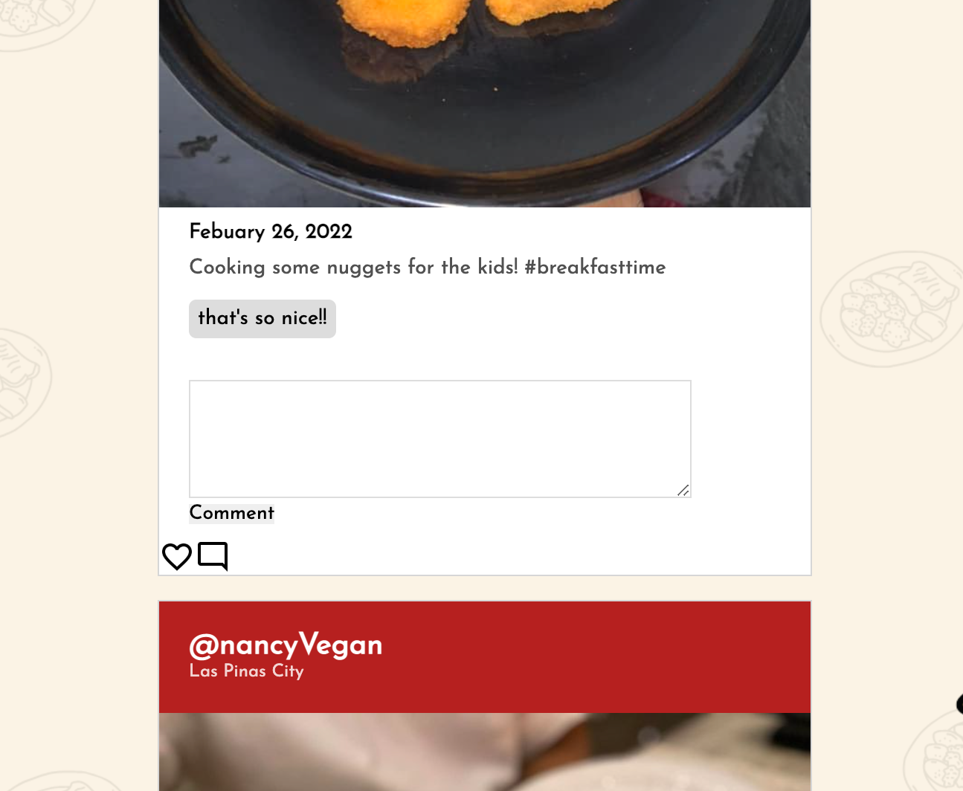
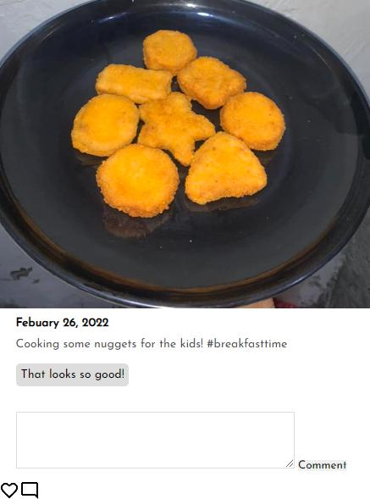
Comment

Slide 8
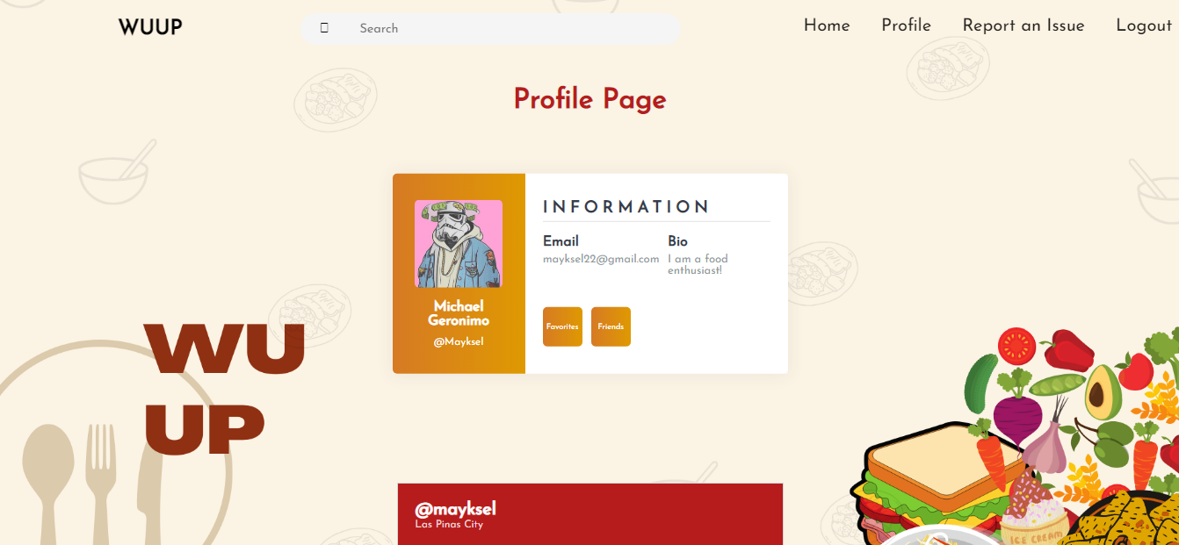
Profile

Slide 9
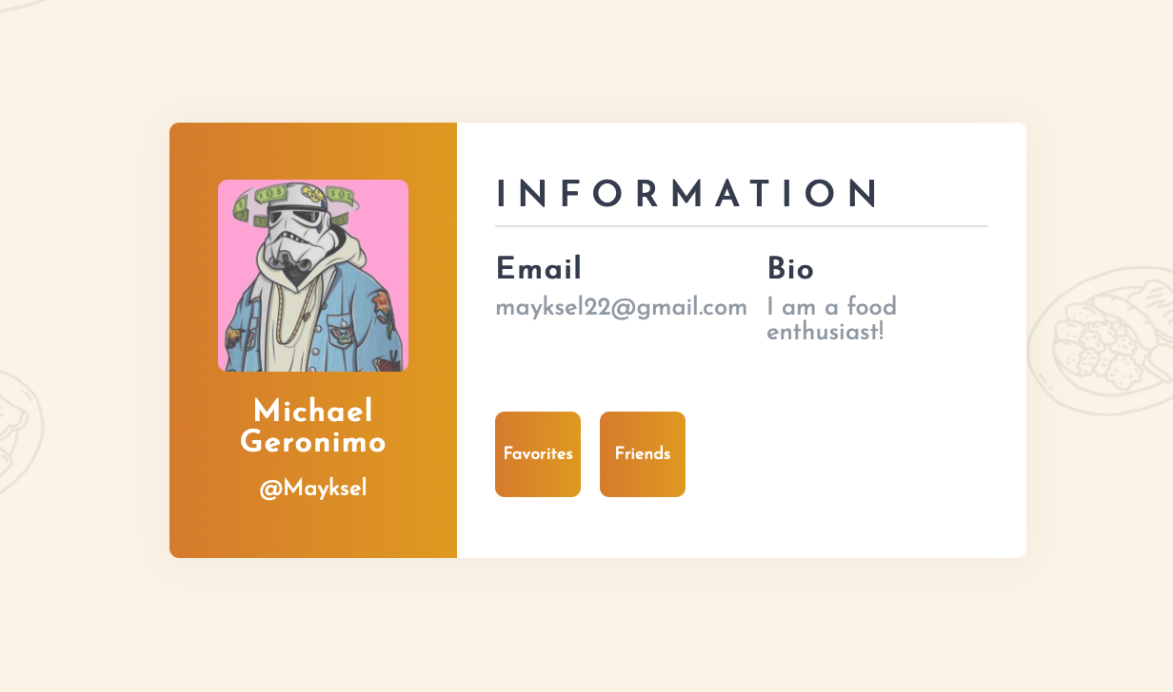
Favorites

Slide 10

Search

Slide 11
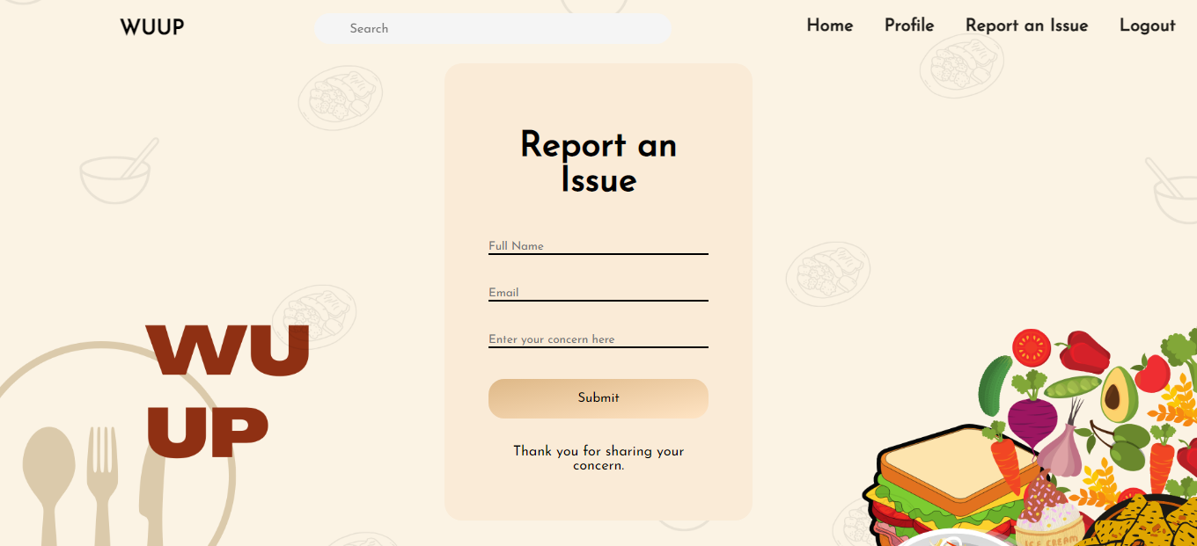
Report An Issue

Slide 12
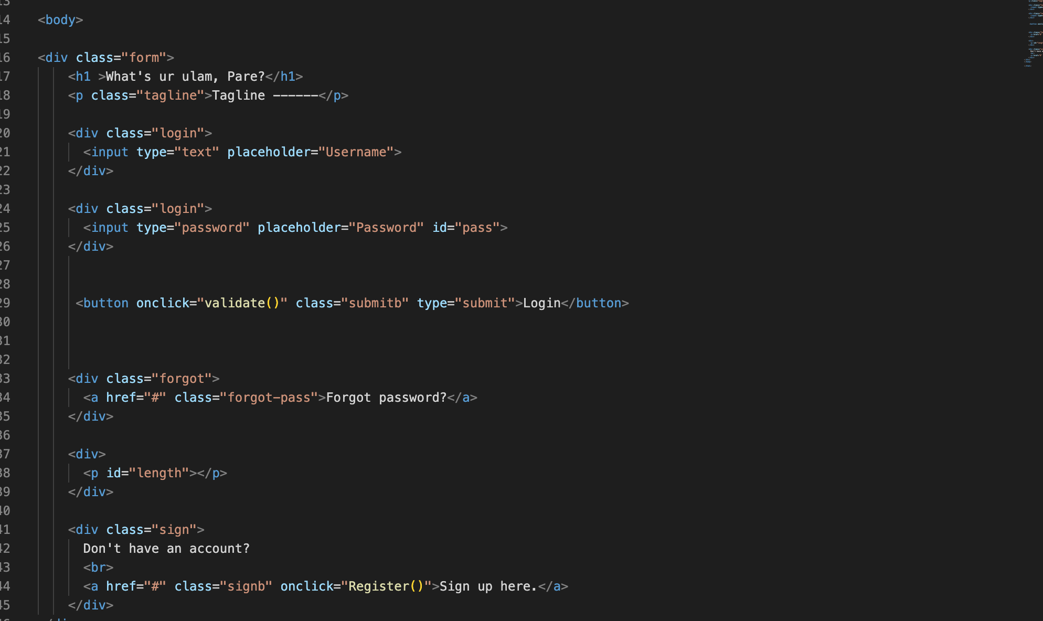
HTML Files
Index.html

Slide 13
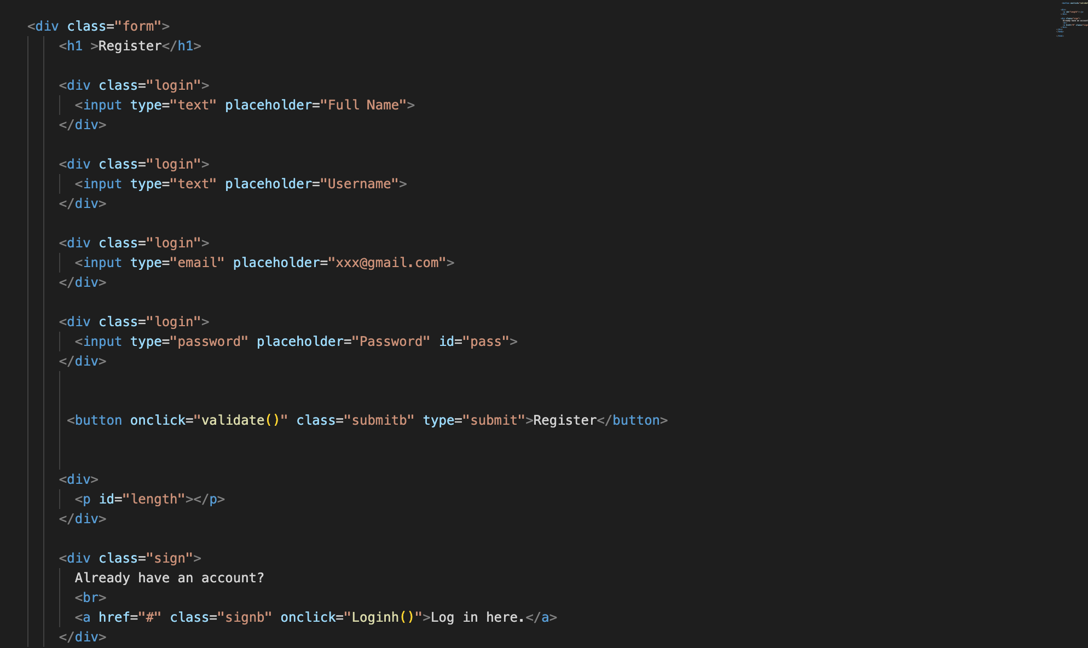
Register.html

Slide 14
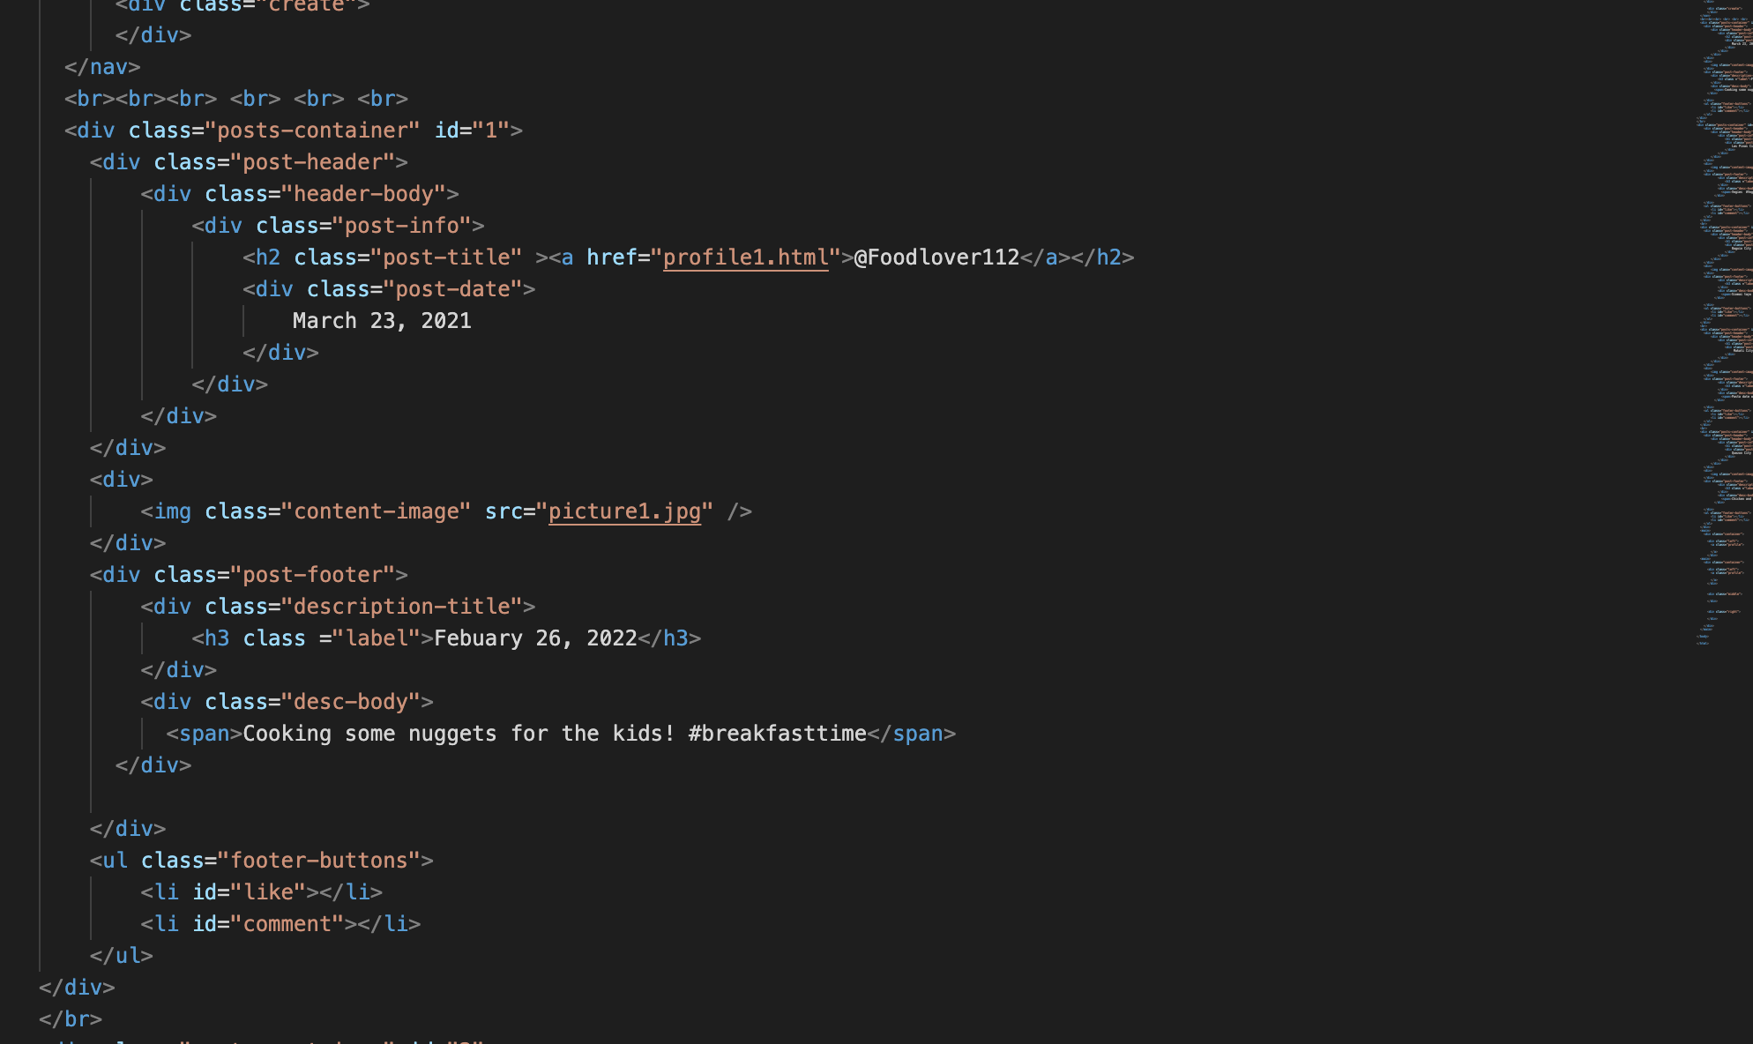
Home.html

Slide 15
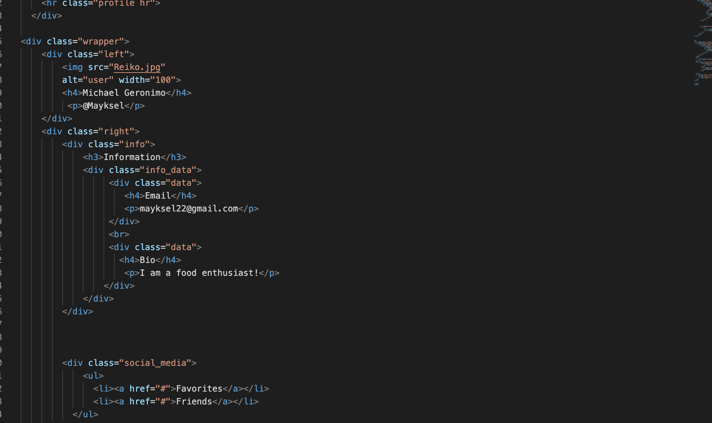
Profile.html

Slide 16
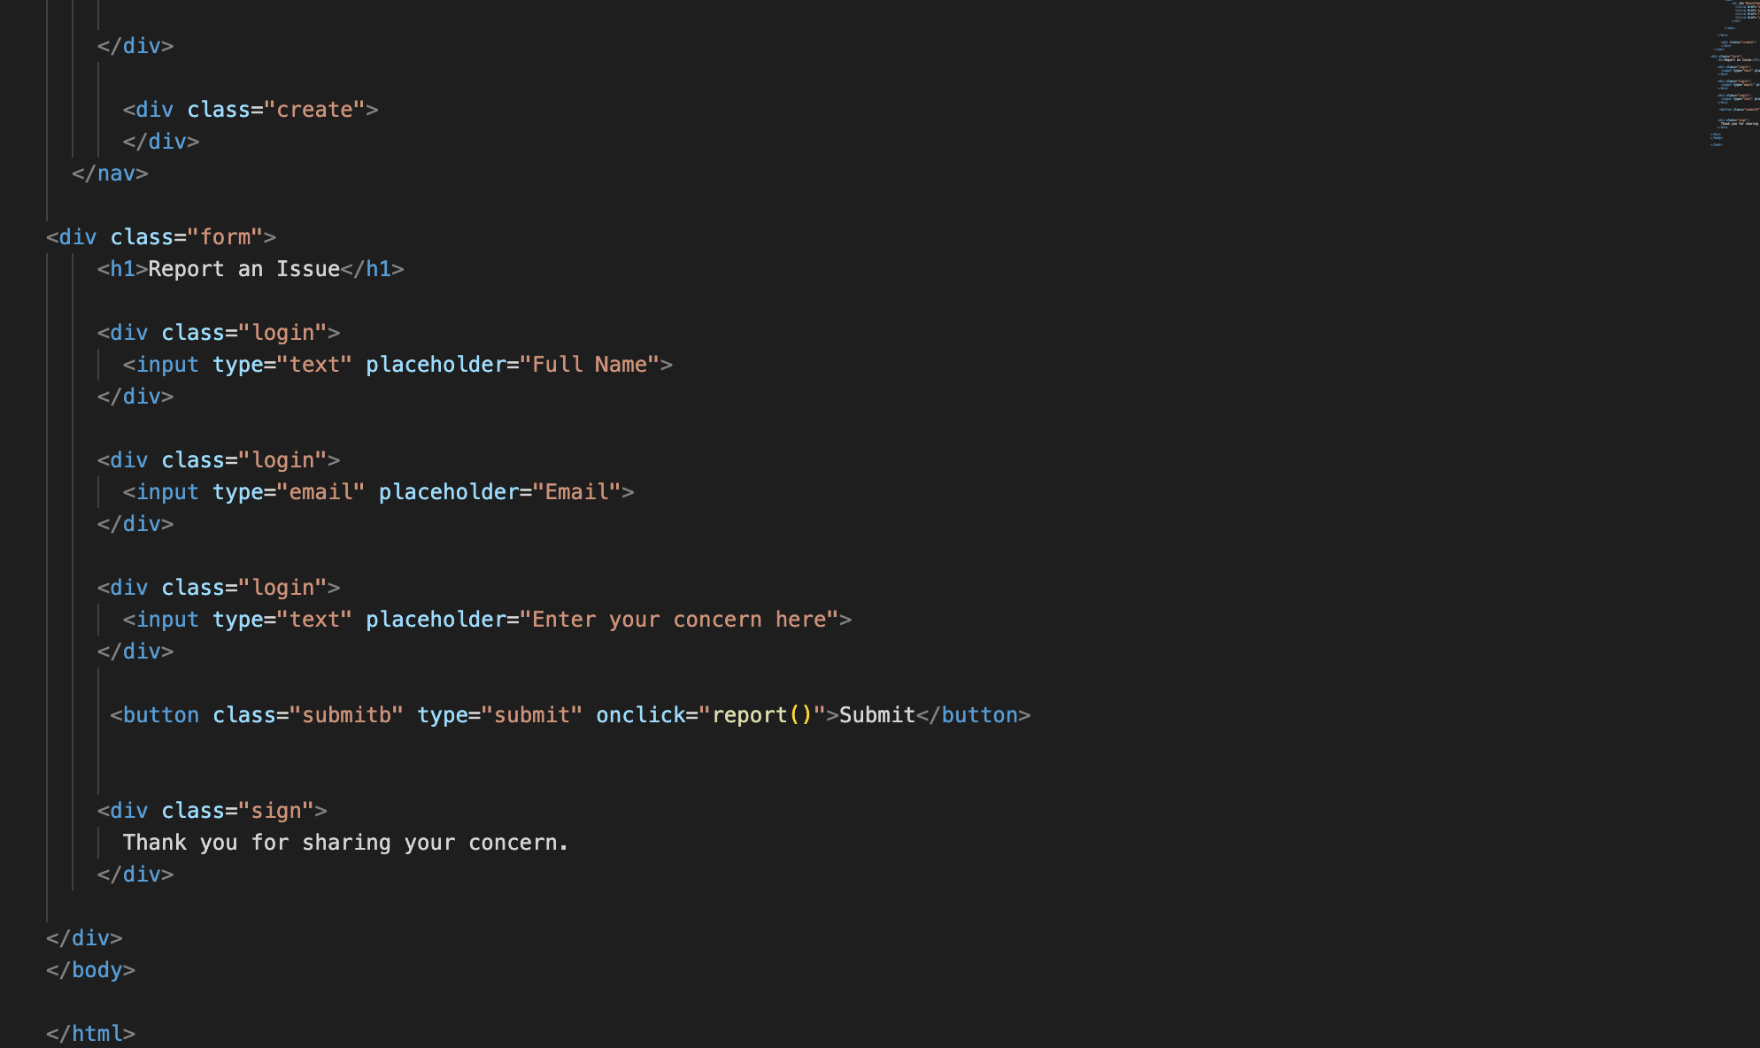
Report.html

Slide 17
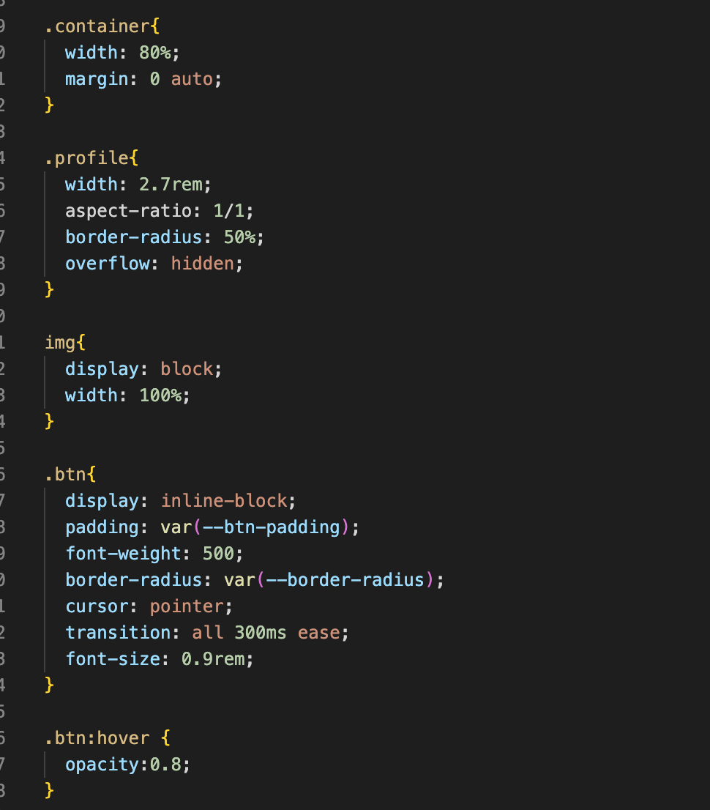
CSS Files
Home_style.css

Slide 18
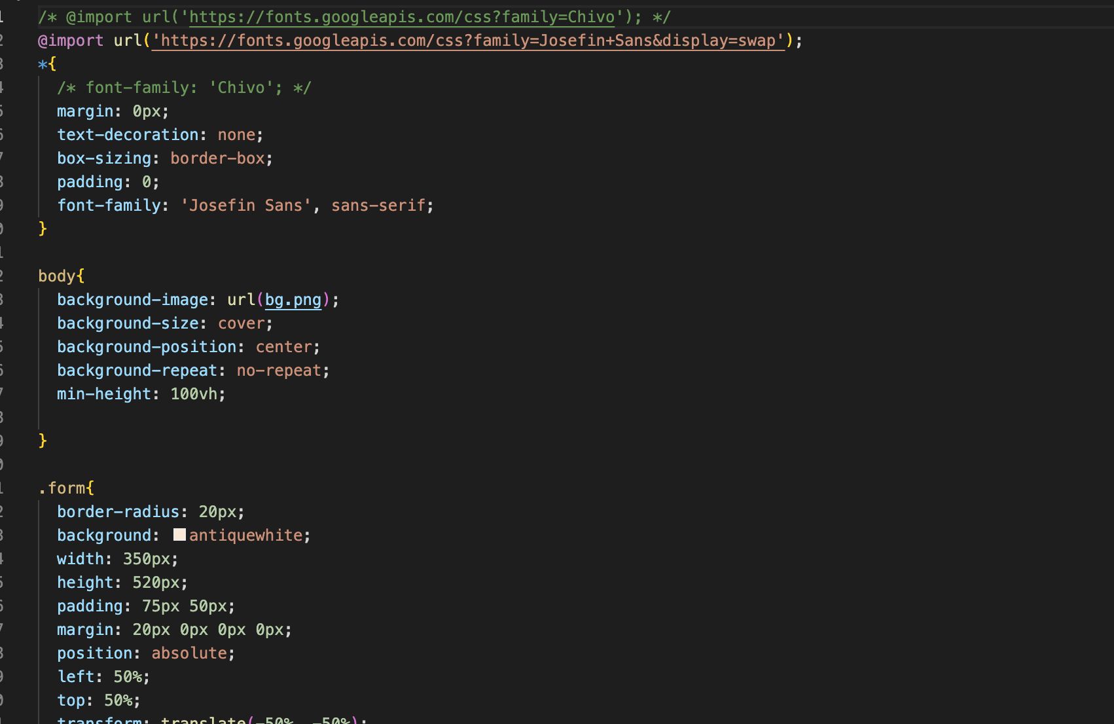
Style.css

Slide 19
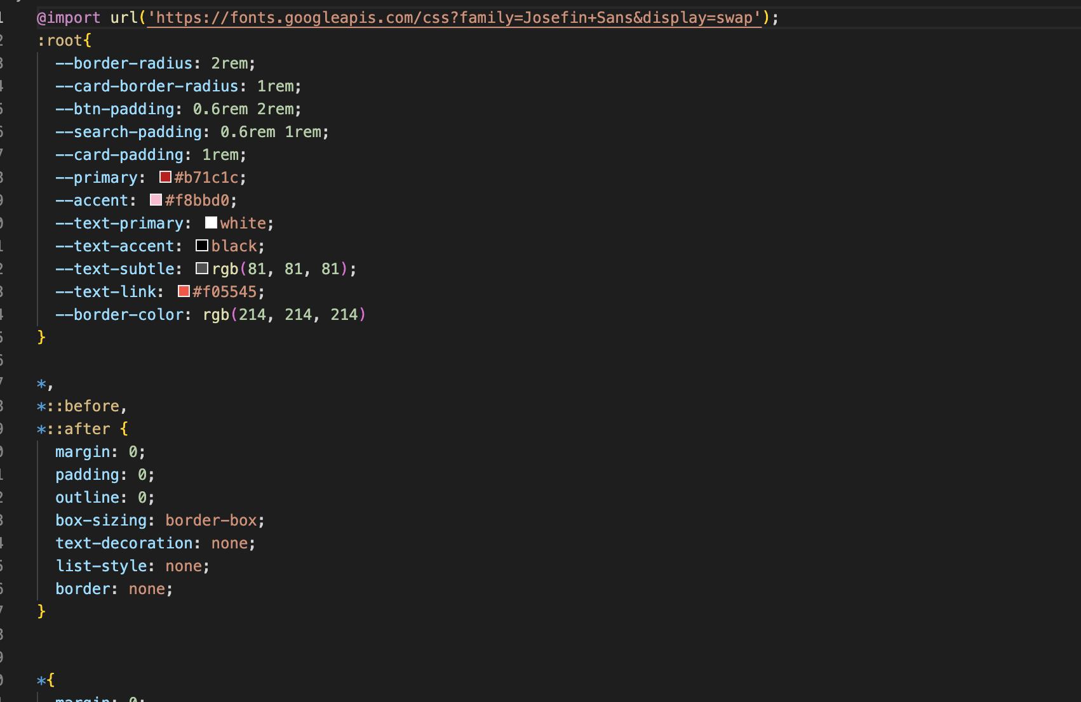
Styles.css

Slide 20
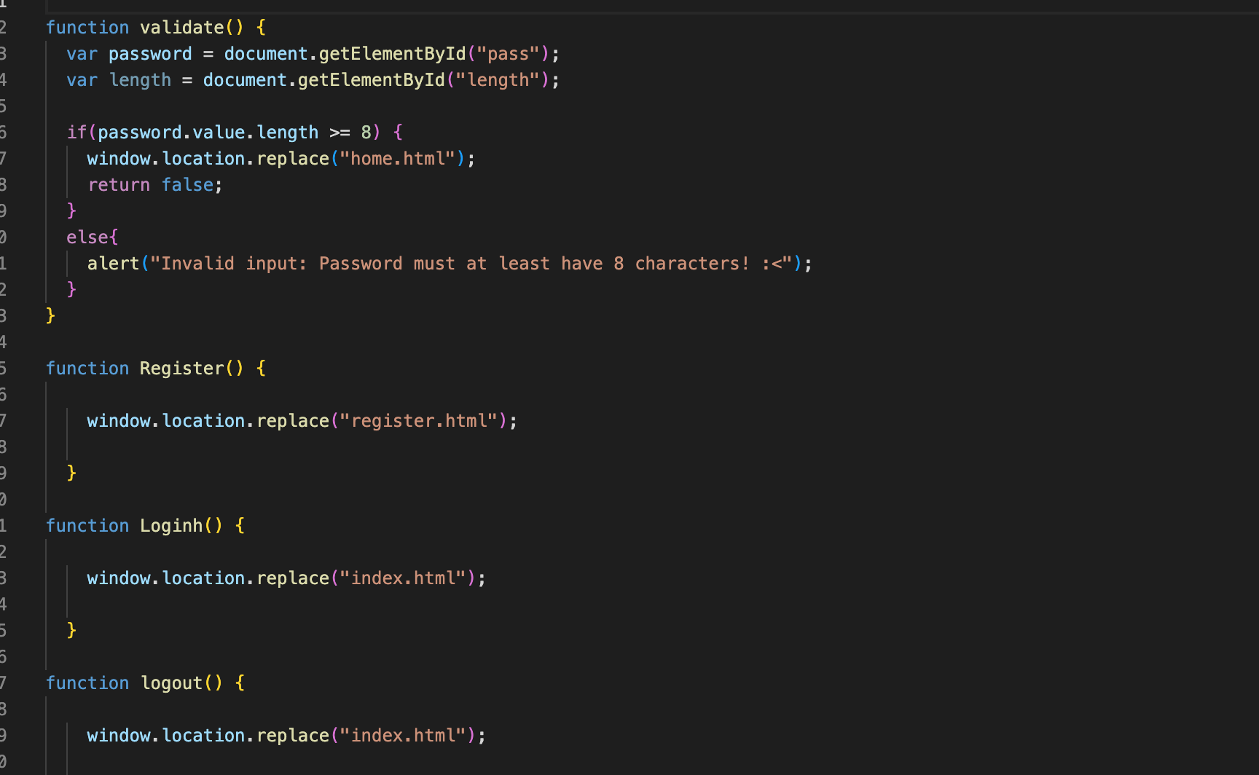
JavaScript File
Script.js

Slide 21
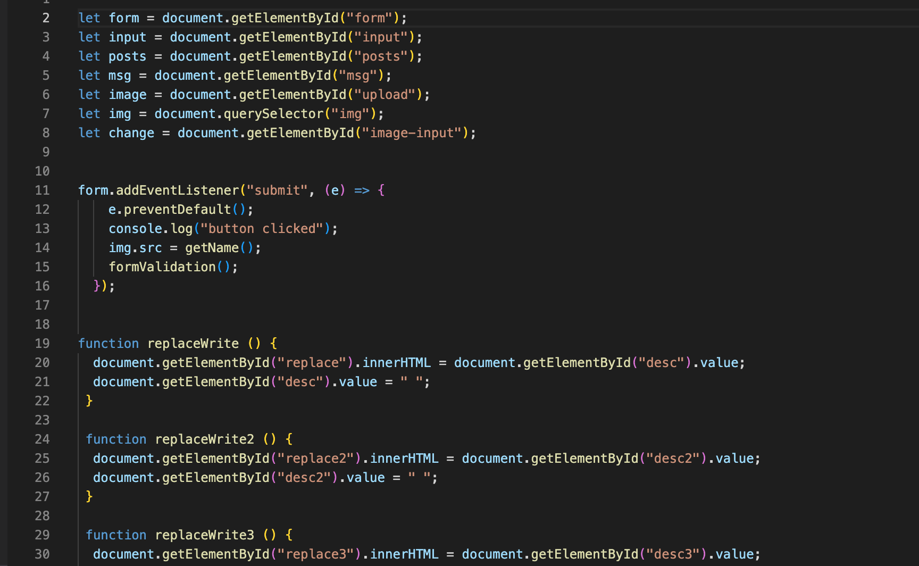
Script_post.js

Slide 22
Thank you!

